Slide 1
Patient Safety
Priorities Update
Mid & South Essex Integrated Care Board
Thursday 18th May 2023
Karen Flitton
Patient Safety Specialist (System)
Nursing & Quality Directorate
Notes:
I ensure the localised implementation of the NHS patient safety strategy and other national safety priorities across the Mid & South Essex Integrated Care System (MSE ICS).

Slide 2

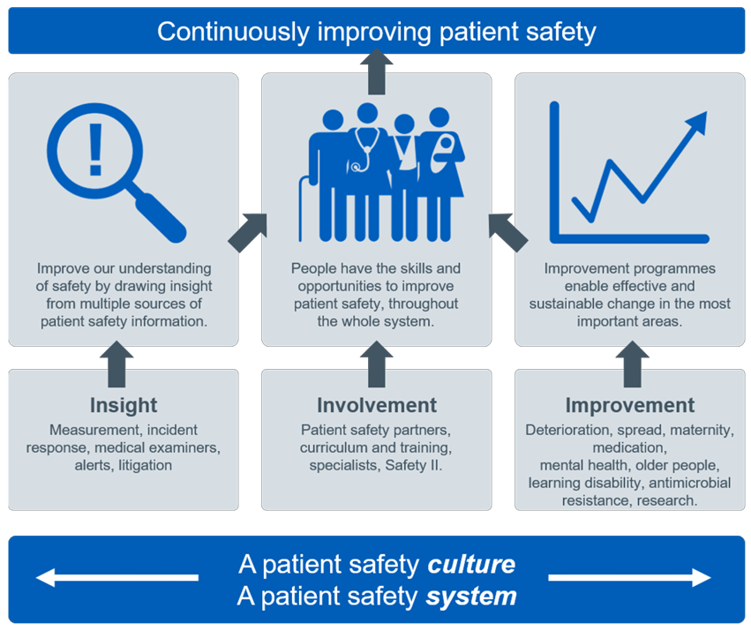
The NHS Patient Safety Strategy
Published in 2019
Rrefreshed in June 2021 to be updated Early 2023
Notes:
The NHS Patient Safety Strategy sets out what the NHS will do to achieve its vision to continuously improve patient safety. It describes how the NHS will continuously improve patient safety whilst building on the foundations of a safer culture and safer systems.
In essence patient safety is about maximising the things that go right and minimising the things that go wrong. It is integral to the NHS definition of quality in healthcare, alongside effectiveness and patient experience.

Slide 3
MSE ICB Executive PSS support requirements
From the NHS Patient Safety Strategy
The Patient Safety Specialist was required to be identified by Apr-21. The expectation is 1FTE at band 8 range, but this may be a shared role, or more than 1FTE across large organisations
The PSS’s name(s) has been provided to NHSEI by executive lead for patient safety
An executive lead for patient safety should be identified as the direct contact point for the PSS. The PSS should also link with the NED who leads on patient safety
All Board members should be aware of and support the PSS’s role and discuss as a board agenda item
The PSS priorities document (circulated Jan ) should be reviewed and a PSS work plan agreed with the patient safety executive lead
The PSS should be provided with sufficient resources to undertake their role, network and complete the patient safety training requirements
There should be sufficient support/coaching/mentoring in place for the PSS to progress their personal and leadership development

Slide 4
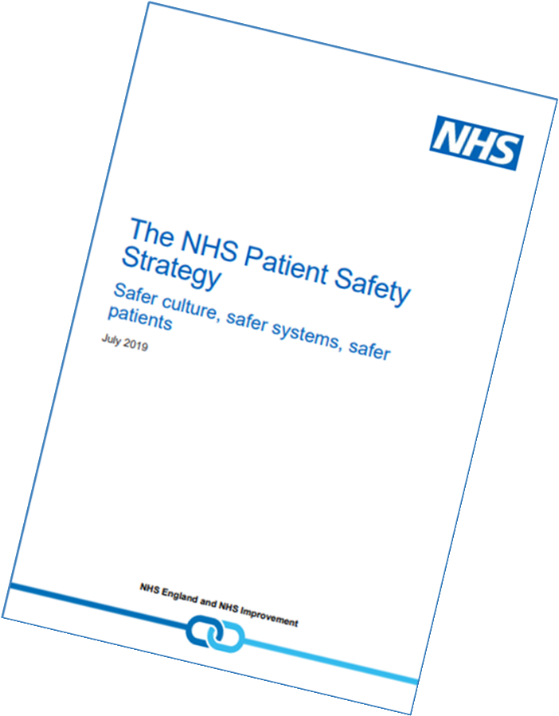
Patient Safety Specialist Eight Key Priorities
Revised January 2023
Transition from NRLS and STEIS to Learning from Patient Safety Events (LFPSE)
Involvement in implementing the new Patient Safety Incident Response Framework (PSIRF)
Improving Safety Culture
Responding to National Patient Safety Alerts
Implement the Framework for Involving Patients in Patient Safety
Improving Patient safety education and training
Addressing Patient Safety Improvement
Implementing Medical Examiners

Slide 5

Implement the Framework for Involving Patients in Patient Safety
The benefits of Patient Safety Partners (PSPs) involvement include:
Supporting the organisation
  To consider how processes appear and feel to patients
  To prioritse of risks that need to be addressed and subsequent improvement programmes
  In developing an action plan following an investigation, particularly so that actions address the needs of patients
Helping the organisation
  Know what is important to patients
  Identify risk by hearing what feels unsafe to patients
  Produce patient information that patients understand and can access
Overall - Promoting openness and transparency
“Patients and their carers should be present, powerful and involved in all levels of healthcare organisations from wards to boards of Trusts”
Don Berwick - 2013
Notes:
The NHS Patient Safety Strategy sets out what the NHS will do to achieve its vision to continuously improve patient safety. It describes how the NHS will continuously improve patient safety whilst building on the foundations of a safer culture and safer systems.
In essence patient safety is about maximising the things that go right and minimising the things that go wrong. It is integral to the NHS definition of quality in healthcare, alongside effectiveness and patient experience.
The benefits of PSP involvement include:
• Promoting openness and transparency
• Supporting the organisation to consider how processes appear and feel to patients
• Helping the organisation know what is important to patients
• Helping the organisation identify risk by hearing what feels unsafe to patients
• Supporting the prioritisation of risks that need to be addressed and subsequent improvement programmes
• Supporting the organisation in developing an action plan following an investigation, particularly so that actions address the needs of patients
• Helping the organisation produce patient information that patients understand and can access.

Slide 6
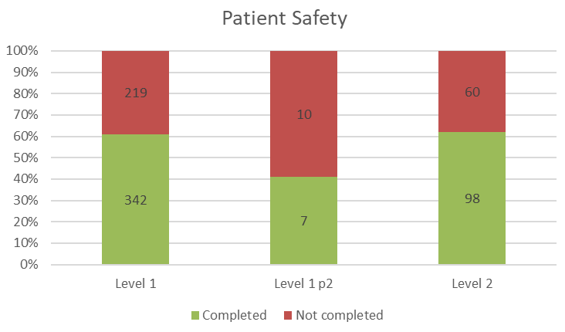
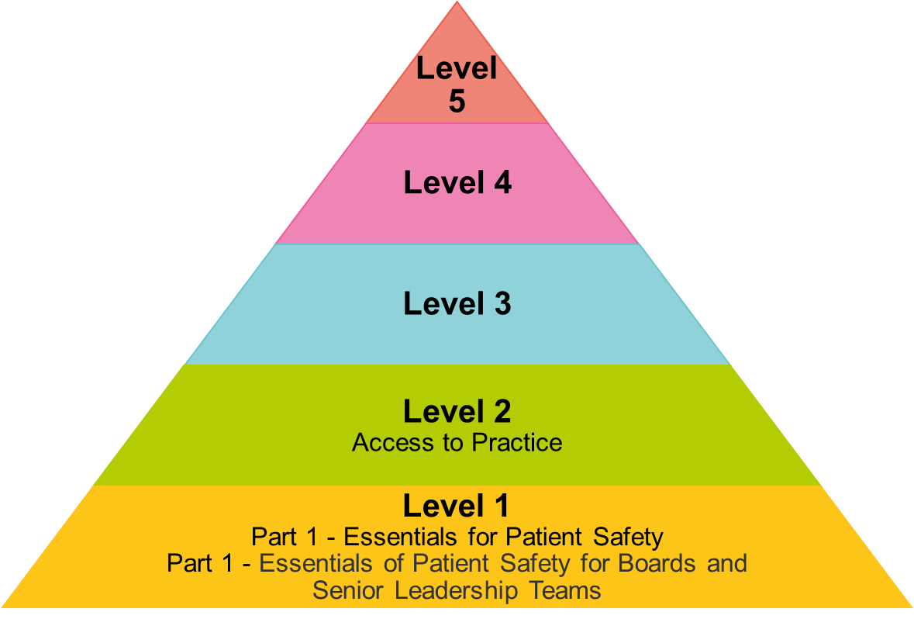

NHS Patient Safety Syllabus
Figures as of 14/04/23
Overall Figures monitored by National Team
Moving Forward
Organisations will deliver these syllabus 2023/2024
Need to be 90% compliant by March 2024
More comms work required
Added to ICB ESR in December 2022
Level 1 – ALL Staff
Level 2 – Staff who hold a clinical qualification
Notes:
The PS training is mandatory for all NHSE staff but is not yet mandatory for all staff across the NHS- however it is likely to be made mandatory for everyone going forward., and many organisations have made it mandatory
Each organisation can decide whether they want to add the modules to their mandatory training and many organisations have done this. As an ICB we should be leading by example and if we are fully committed to the Patient Safety agenda we would want to make sure that all staff have at least a basic understanding of how they can influence patient safety. 😊

Slide 7
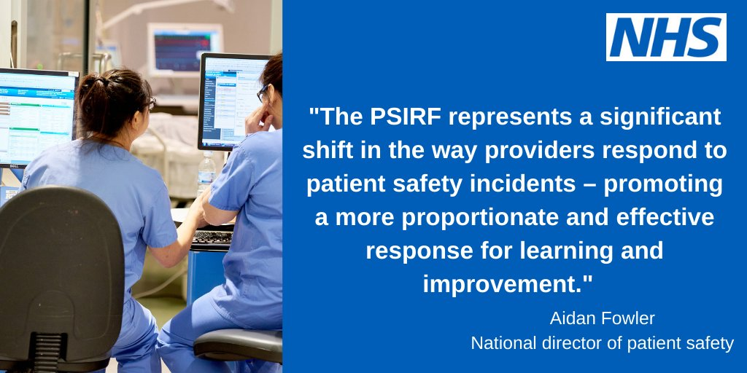
Notes:
PSIRF IS NOT……
just a name change – whilst the product stays the same!

Slide 8

Patient Safety Incident Response Framework (PSIRF)
A New Era in Patient Safety Response……it is a Movement
PSIRF is NOT an investigation framework
Focuses on learning and improving patient safety.
Replaces the Serious Incident Framework and removes the ‘serious incident’ classification and threshold for it
It focuses on patient safety and responding for the purpose of learning and improvement only
Embeds patient safety incident response within a wider system of improvement.
Prompts a significant cultural shift towards systematic patient safety management
Notes:
Old SIF focuses on individuals rather than systems and system improvements
Purpose of PSIRF is about learning and changing patient safety and not looking at things in isolation
PSIRF removes the definition of SERIOUS which may sound scary

Slide 9


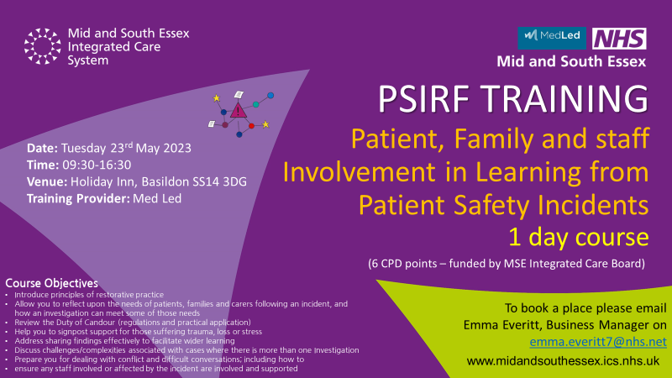

PSIRF Training
MSE Integrated Care System have:
Identified preferred trainer
Purchased sufficient courses to train the ICB staff and a selection of staff within the providers with a focus on smaller contracts within MSE especially charitable organisations
Negotiated a 15% discount on prices with Med Led until March 2024 on other courses purchased within our system
Bespoke 45 minute session arranged for Board members on 24th August 2023 via MS Teams

Slide 10
PSIRF – How is oversight changing?
What does this mean as an ICB
August 2022  12 month Transition Programme  Autumn 2023
Serious Incident Framework | Patient Safety Incident Response Framework
Monitor numbers/themes and timescales Review Serious Incidents for sign off approval | Develop, agree, maintain and review patient safety incident response plans Oversee and support effectiveness of systems to achieve improvement following Patient Safety Investigations Support co-ordination of cross-system learning responses Share insights and information across organisations /service to improve safety

Slide 11


PSIRF
Improved Learning & Assurance
More in-depth investigations
Better Quality of investigations
RCAs have not served us well, became a paper exercise, focused on finding a root cause and action plans never to be looked at again
PSIRF focuses on developing a Quality Improvement programme – aimed at embedding learning
SERIOUS INCIDENT FRAMEWORK (SIF 2015)
PATIENT SAFETY INCIDENT REPSONSE FRAMEWORK
(PSIRF 2022)
Notes:
Considerate and proportionate response
As a system need to ensure that the learning gets shared and implemented

Slide 12
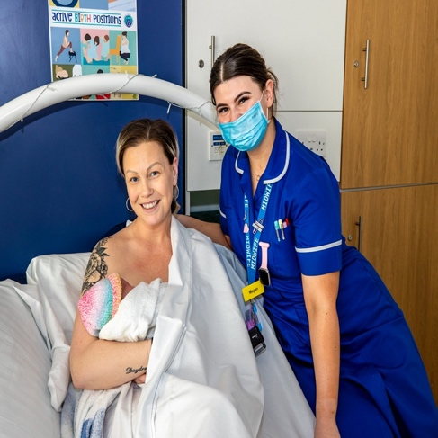
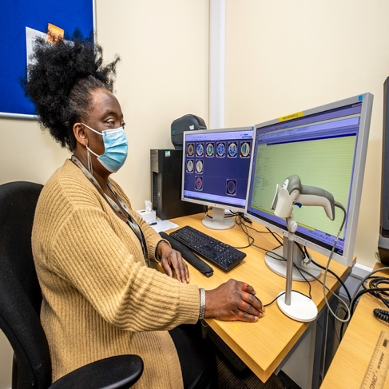
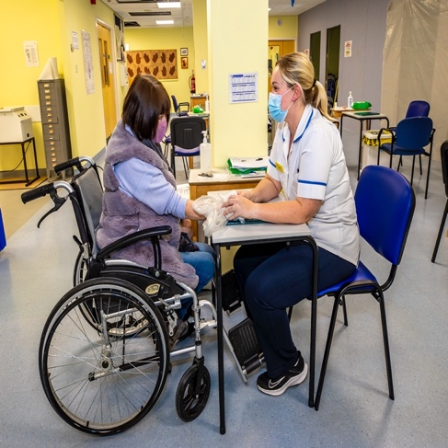
IN SUMMARY………………….
We need to establish a robust process whereby the learning from patient safety incidents are shared across the system, the region and the national teams
Learning is at the heart of PSIRF
We need to work in partnership across the system
Notes:
PSIRF is a really ambitious transformation programme and gives us an opportunity to fundamentally change how we improve patient care.
See it as a positive
We need to embrace it
Reduce duplication of work
Share best practice
Support each other

Slide 13

QUESTIONS

Slide 14

Karen Flitton
k.flitton@nhs.net
Further Reading & Resources
  NHS England » Patient safety
  NHS England » Framework for involving patients in patient safety
  NHS England » Patient Safety Specialists
  Patient Safety | Health Education England (hee.nhs.uk)
  NHS England » Patient Safety Incident Response Framework

